Slide 1
Audactive
Dr Geoff Elliott
geoffe@Pembrokeshire.ac.uk
Pembrokeshire College

Slide 2
About Audactive - overview
Teaching Learning and Assessment Tool
Project initiated by Pembrokeshire College and funded by Ufi VocTech
Tool to support teachers creating and sharing online resources with text, images, video, assessments and notetaking
Unique feature is integrating text-to-speech and speech-to-text
Multilingual
Great for all learners, particular benefits for dyslexia, VI, ESOL, MFL

Slide 3
Work over last two years
Phase 1 Working with 8 FE colleges focus on generic uses as well as accessibility, especially dyslexia and VI. One partner was Royal National College for the Blind
Phase 2
Working with 80 plus colleges, schools and universities with focus on ESOL and MFL
Method
Develop, train, test, review and feedback then further development then repeat

Slide 4
The Audactive Partnership
Pembrokeshire College – lead Geoff Elliott
Ufi VocTech Trust – funding
WellSource – Software development
Peter Kilcoyne Consulting – Project Management
Blended Learning Consortium – Partnership support
Terus elearning – LTI development (VLE integration)
Approx. 100 colleges, schools, and universities in UK and around the world
Over 10,000 learners and 150 teachers
Transform Education - Training

Slide 5
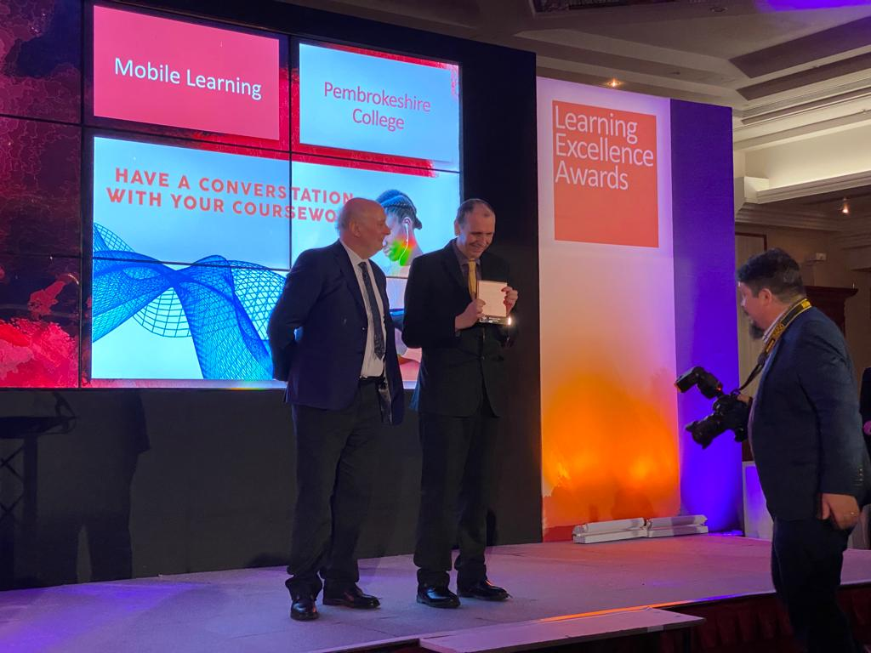
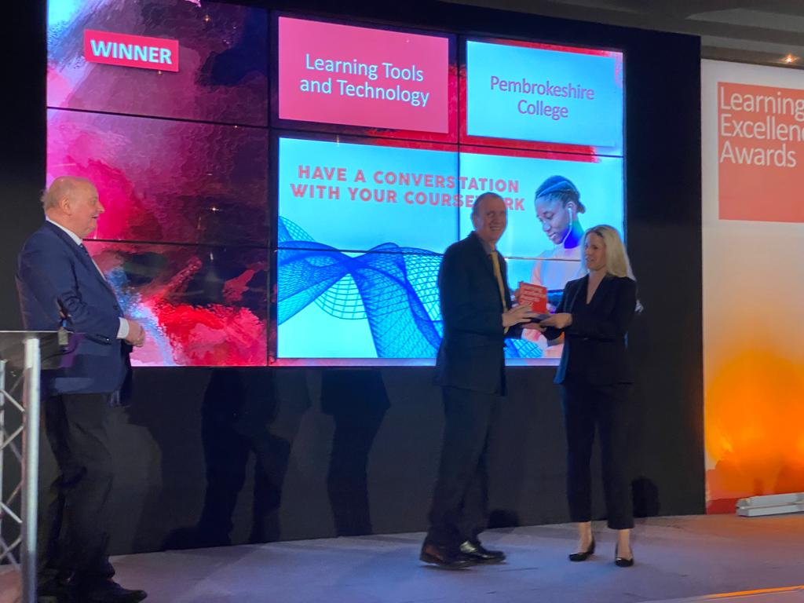
Winning two prestigious awards

Slide 6
Demonstration – The platform, www.audactive.com

Slide 7
Teach Page

Slide 8
Building a resource

Slide 9
Building a new resource

Slide 10
Sharing your resource with students

Slide 11
Learner view of the resource

Slide 12
The Gradebook

Slide 13
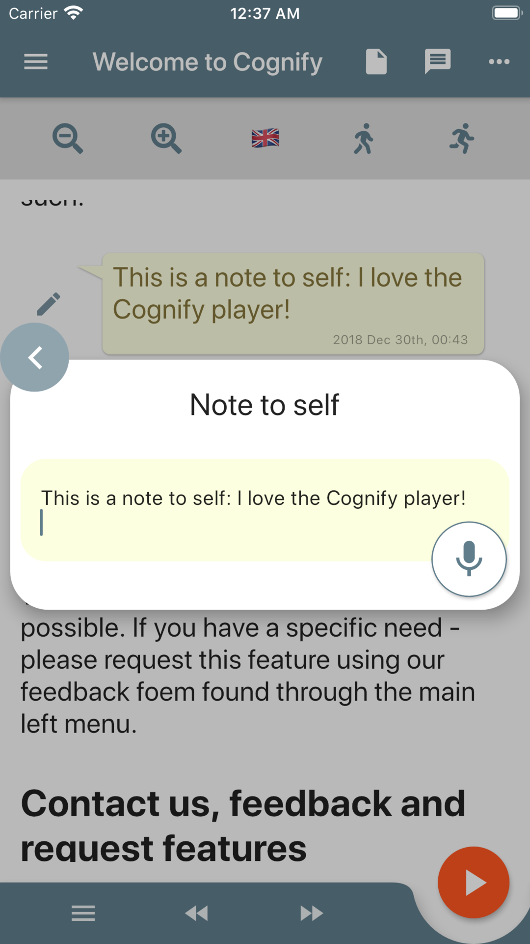
Audactive App
Free download on IoS and Android stores
Read or listen to Audactive resource on your mobile or tablet
Submit answers
Also import and listen to any webpage

Slide 14
Feedback from Learners
“Due to my dyslexia it was easier for me to hear the words than read them.”
“Helps me understand it more rather then reading it myself.”
“i am dylexic so the tool for it to read the text out for you saved me some time as it would take me 20 minutes to read a single paragraph. i also like the pace of the speaker.”
“As someone with ADHD, the text to voice is useful. The embedded Youtube videos were good.”
“I liked the voice to text feature for leaving notes,”
“Reading out some biology notes to me whilst I made dinner.”
“Easy use to watch/read and then confirm knowledge by the use of the questions/text boxes.”

Slide 15
Feedback from Teachers
“It is a good way for student's to have access to course materials and lectures during remote learning. the students I surveyed would find it useful to be able to look at the teachers presentations in their own time.”
“ Audactive is a great tool for supporting learners with dyslexia - the text-to-speech and highlighting function are fantastic tools.”
“Like a podcast style which is great can be used remotely especially when commuting to college.”
“They had the additional option of listening to the text, which assisted with understanding and pronunciation of unfamiliar vocabulary”
“The students reported back in class that they really enjoyed it because they were able to hear the text as well as read it.”
“fun & independence out of class”

Slide 16
What’s the difference?
 | Microsoft | Google | Audactive
Voice-to-Text | P | P | P
Text-to-Voice | P | P | P
Design voice-based MCQs |  |  | P
Design voice-based open questions |  |  | P
Design the response language |  |  | P
Store learner responses | P | P | P
Send learner responses to VLE |  |  | P

Slide 17
Any Questions?
Have a go, it’s free?
further support and training
geoffe@Pembrokeshire.ac.uk
Geoff.elliott@gmail.com

